Slide 1

How the Web Works
HTML & CSS

Slide 2

The Internet
At its most basic, the internet is just a global network of computers designed to allow easy sharing of files and data
Originally designed as an “in-house” file sharing system, as part of the US Department of Defence, known as “ARPANET” in the 1960s and early 1970s
It gradually expanded to its eventual use by ISPs in the late 1980s and began to have wide scale use by the public
With the help of Tim Berners Lee making the net “flatter”, it grew into the modern conception of the World Wide Web we know today

Slide 3

World Wide Web
Since its conception, the World Wide Web has established conventions/rules (“PROTOCOLS”) to ensure consensus
Each computer has an IP Address (eg. 73.158.6.61) – think of it like your house number, street & suburb but in just numbers!
Computers agree to “talk” to each other using the “TCP/IP Protocol” & it determines how computers transfer data to each other
HTTP handles the web traffic and how requests & responses to websites are handled

Slide 4

TCP & HTTP Paired
To access a webpage & issue HTTP requests/responses, a TCP connection first needs to be established
These concepts are not easy to understand straight away, but are important to flag early, just so you are familiar with the terms! We will revisit across the Certificate 4 (and Diploma!)
A rough analogy: Think of TCP like a draw bridge, and the HTTP Requests and Responses like cars going back and forth across it!

Slide 5

Web Servers
Transfer of data is how our websites are DELIVERED – but where are our public websites hosted from, where this data is accessed & stored?
Websites are just folders, made up of several files/pages. These files are stored on computers that run a piece of software called a web server
Hosting companies provide space on a server for your website
Domain names can be purchased from registrars and linked to your hosting account/web server. DNS is used to map IP addresses to domain names

Slide 6
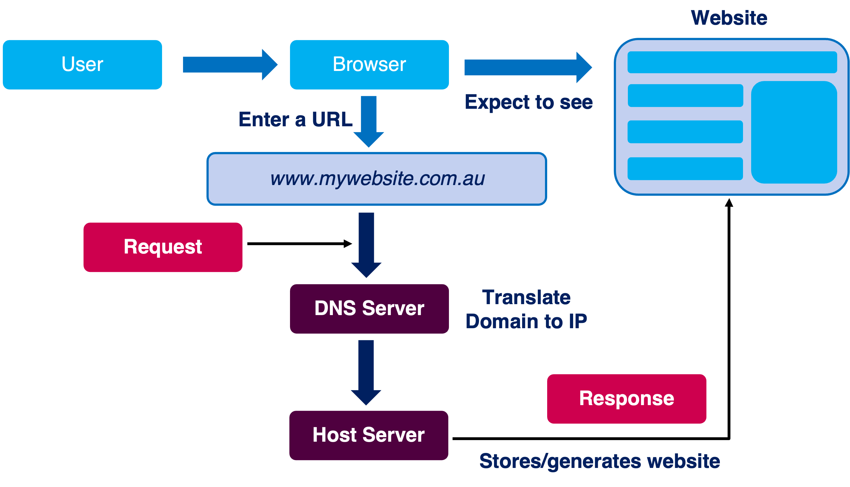
How the Web Works: Loading a Webpage

Slide 7

How the Web Works: Domain Name System (DNS)

